Slide 1


Slide 2

Java OOP and Data Structures with Introduction to Secure Coding
Dr. Ziping Liu
Chapter 20 AVL Trees

Slide 3
https://he.kendallhunt.com/product/java-oop-and-data-structures-introduction-secure-coding
Chapter 20 AVL Trees

Slide 4

Chapter Outlines
What is an AVL tree
Techniques to balance a binary search tree
Iterative implementation in insertion in an AVL tree
Recursive implementation in insertion in an AVL tree
Iterative implementation in deletion in an AVL tree
Recursive implementation in deletion in an AVL tree
Application driver for the AVL tree class

Slide 5
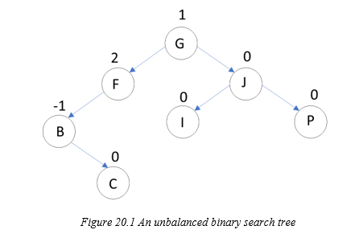
20.1 What Is an AVL Tree?
a self-balancing binary search tree
its balance is maintained by ensuring that the height difference (balance factor) between a node’s left and right subtrees does not exceed one
node height: the number of edges along the longest path from the node to a leaf
tree height: root node height

Slide 6
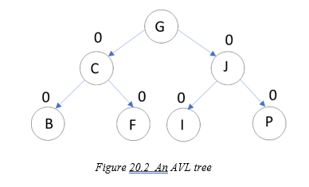
20.1 What Is an AVL Tree?
To balance a binary search tree, each node must be balanced. This is typically achieved by calculating a node's balance factor, which is the height difference between its left subtree and right subtree. A balanced node will have a balance factor of -1, 0, or 1.

Slide 7
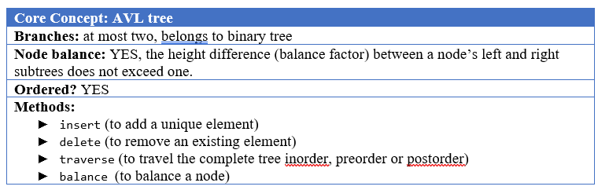
20.1 What Is an AVL Tree?

Slide 8
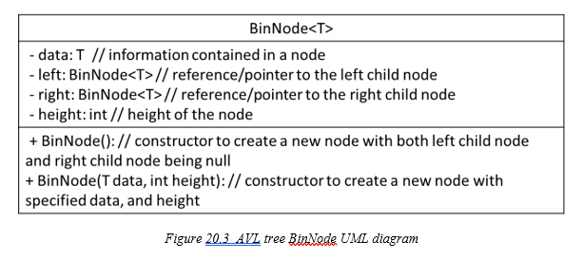
20.1 What Is an AVL Tree?

Slide 9
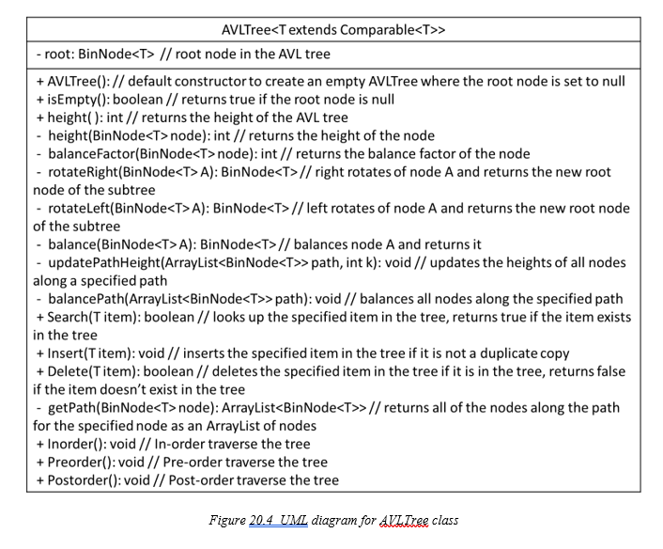
20.1 What Is an AVL Tree?

Slide 10
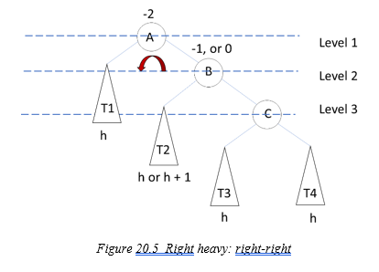
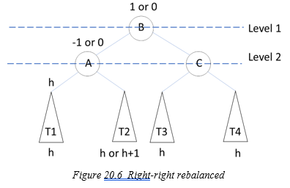
20.2 Techniques to Balance a Node in an AVL Tree
Case 1: right-right(right heavy), call rotateLeft(BinNode<T> A)
To restore balance, a left rotation is performed on node A:
  Node B’s right subtree, T2, becomes node A’s right child.
  Node A becomes the left child of node B.

Slide 11
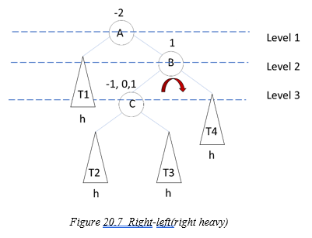
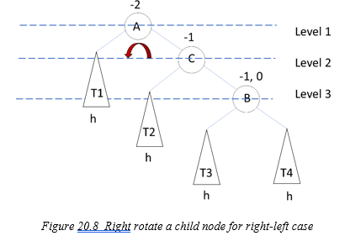
20.2 Techniques to Balance a Node in an AVL Tree
case 2: right-left(right heavy), call rotateRight(BinNode<T> B) then call call rotateLeft(BinNode<T> A)
To restore balance:
  Perform a right rotation on node B to make it the right child of node C.
  Reassign T3 as the left subtree of node B

Slide 12
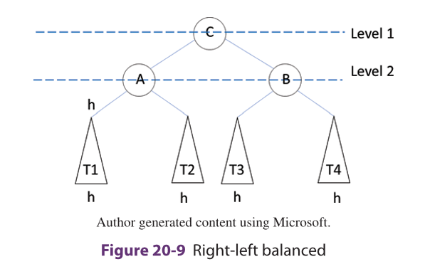
20.2 Techniques to Balance a Node in an AVL Tree
case 2: right-left(right heavy), call rotateRight(BinNode<T> B) then call call rotateLeft(BinNode<T> A)
To restore balance:
  still unbalanced but has now been transformed into a right-right case. To balance the subtree, we perform another left rotation on node A.

Slide 13
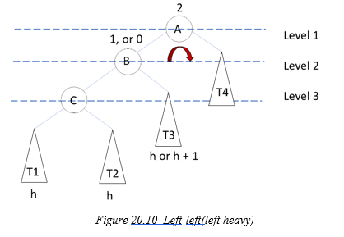
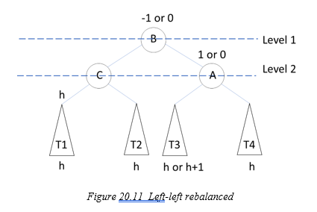
20.2 Techniques to Balance a Node in an AVL Tree
Case 3: left-left(left heavy) , call rotateRight(BinNode<T> A)
To restore balance:
  Perform a right rotation on node A to make T3 the left subtree of node A.
  Reassign node A as the right child of node B.

Slide 14
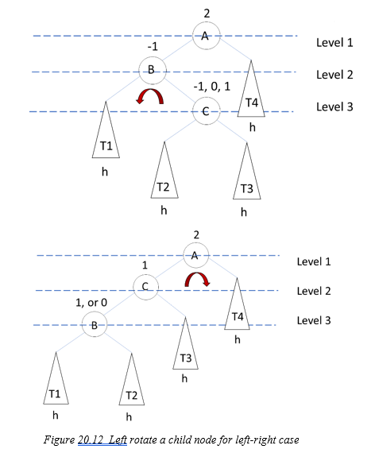
20.2 Techniques to Balance a Node in an AVL Tree
Case 4: Left-right(left heavy), call rotateLeft(BinNode<T> B) then call call rotateRight(BinNode<T> A)
To restore balance:
  Perform left rotate node B to make it the left child of node C.
  Make T2 the right subtree of node B.

Slide 15
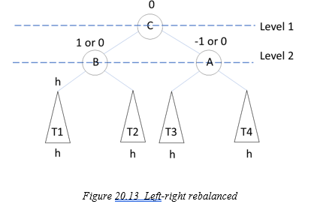
20.2 Techniques to Balance a Node in an AVL Tree
Case 4: Left-right(left heavy), call rotateLeft(BinNode<T> B) then call call rotateRight(BinNode<T> A)
To restore balance:
  Perform left rotate node B to make it the left child of node C.
  Make T2 the right subtree of node B.

Slide 16
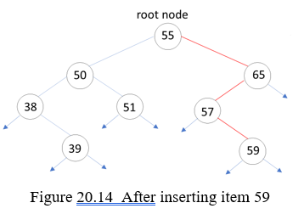
20.3 Iterative Implementation of Insertion in an AVL Tree
before inserting 59, the AVL tree is balanced.
After inserting 59, node 65 is not balanced
Thus, all nodes along the search path need to be rebalanced, starting at the parent node of the newly inserted node and moving up to the root node.

Slide 17
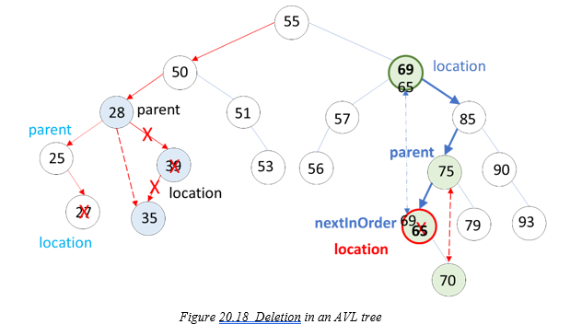
20.4 Iterative Implementation of Deletion in an AVL Tree
After deleting a node, update the heights of all nodes along the path from the root node to the parent node.
rebalance each node along this path. Balancing is performed bottom-up, starting from the parent node and moving up to the root node.

Slide 18
20.5 Recursive Implementation of Insertion and Deletion in an AVL Tree
Recursive InsertNode() method takes two parameters: a node and an item. The method recursively calls itself with either the left or right child of the current node until it reaches a null node or finds that the item is already present in the tree, at which point the recursion terminates.
To insert an item into an AVL tree, the Insert2() method calls the InsertNode() method, passing the root node as the starting node. After the node is inserted, the heights of all nodes along the search path are updated in a backward manner. Additionally, all nodes along the search path are balanced as part of this process.

Slide 19
20.5 Recursive Implementation of Insertion and Deletion in an AVL Tree
The recursive deleteNode() method takes two parameters: a node and an item. The method recursively calls itself with either the left or right child of the current node, provided the left or right child is not null or the item has not been found. If one of the child nodes is null, the method returns the other non-null child node.
If both child nodes are not null, the nextInOrder() method is called to find the next in-order node. Then, the recursive deleteNextInOrder() method is called to delete the next in-order node, balance the respective subtree, and reconnect the parent node with the updated subtree.
To delete an item from an AVL tree, the Delete2() method calls the deleteNode() method, passing the root node as the starting node. After the node is deleted, the heights of all nodes along the search path are updated in reverse order. Furthermore, all nodes along the search path are rebalanced as part of this process.

Slide 20


Slide 21


Slide 22
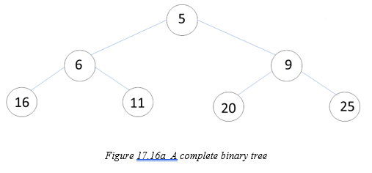
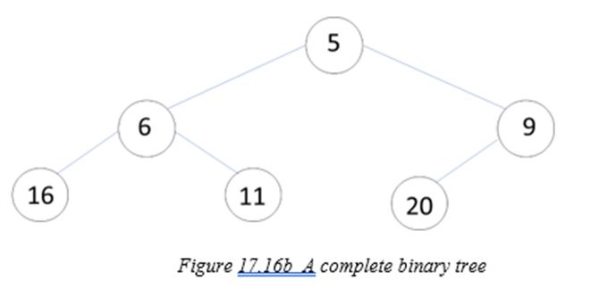
17.7 Heapsort
A complete binary tree is a binary tree where all non-leaf nodes must have two child nodes if there are enough nodes, and the leaf nodes must be filled from left to right.

Slide 23
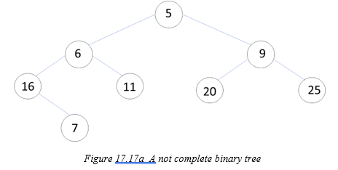
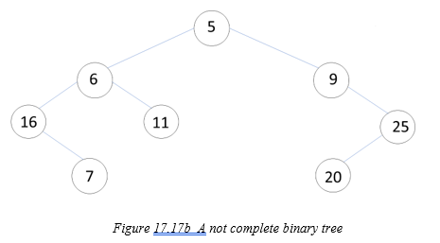
17.7 Heapsort
A complete binary tree is a binary tree where all non-leaf nodes must have two child nodes if there are enough nodes, and the leaf nodes must be filled from left to right.

Slide 24
17.7 Heapsort
For a complete binary tree, if every node is arranged such that it contains the minimum value (or maximum value) in the subtree rooted at the node, the binary tree is then a min-heap (or max-heap) data structure. In a min-heap, for every node, the value of the node is less than or equal to the values of its children, ensuring that the minimum value is at the root, and the property is recursively satisfied for all subtrees. Similarly, in a max-heap, every node contains a value greater than or equal to its children's values, ensuring that the maximum value is at the root.

Slide 25
17.7 Heapsort
Even though a heap is a binary tree, implementing a heap using an array-style data structure, such as an ArrayList, is often a better choice than using a linked implementation. This is because a heap is a complete binary tree, and the structure of the heap allows for efficient access to its elements using an array.
In a heap, the relationship between the indices of a node and its children is straightforward. If a node is located at index [k], the indices of its left and right children can be determined as follows:
  Left child index: [2 * k + 1]
  Right child index: [2 * k + 2]

Slide 26
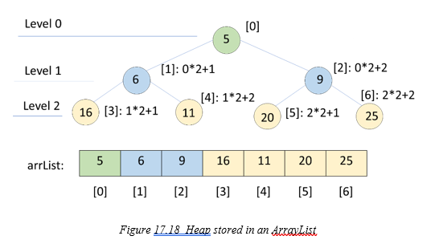
17.7 Heapsort
In the above-defined relationship, if the calculated left child or right child index is greater than the size of the array minus 1, it indicates that the child node does not exist.
Additionally, if a node’s location index is k, the location index of its parent node is given by (k - 1) / 2, provided the parent node exists. Therefore, for a valid parent node, the index (k - 1) / 2 must be greater than or equal to zero. This ensures that the parent node is within the bounds of the array.

Slide 27
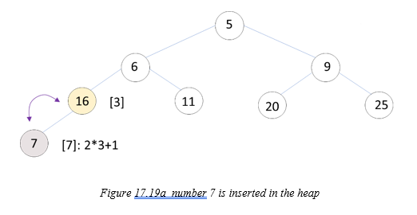
17.7 Heapsort
number 7 is inserted in the heap

Slide 28
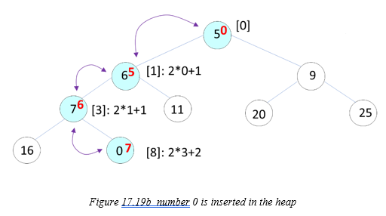
17.7 Heapsort
number 0 is inserted in the heap

Slide 29
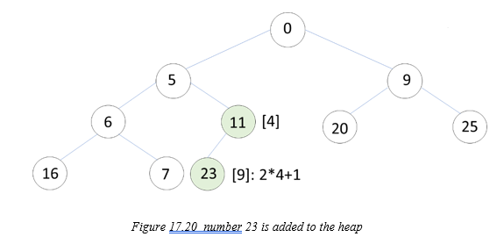
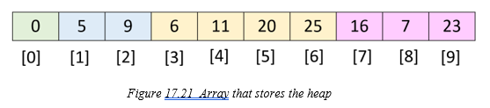
17.7 Heapsort
number 23 is inserted in the heap

Slide 30
Which National Park is it?
Answer: Great Sand Dunes National Park and Preserve

